Slide 1


Slide 2


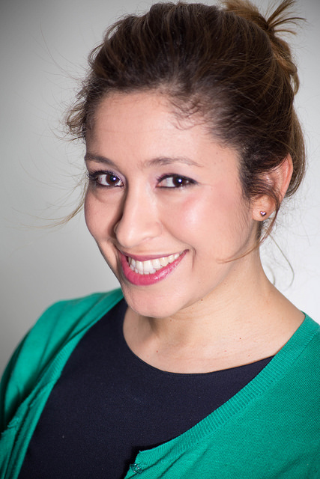
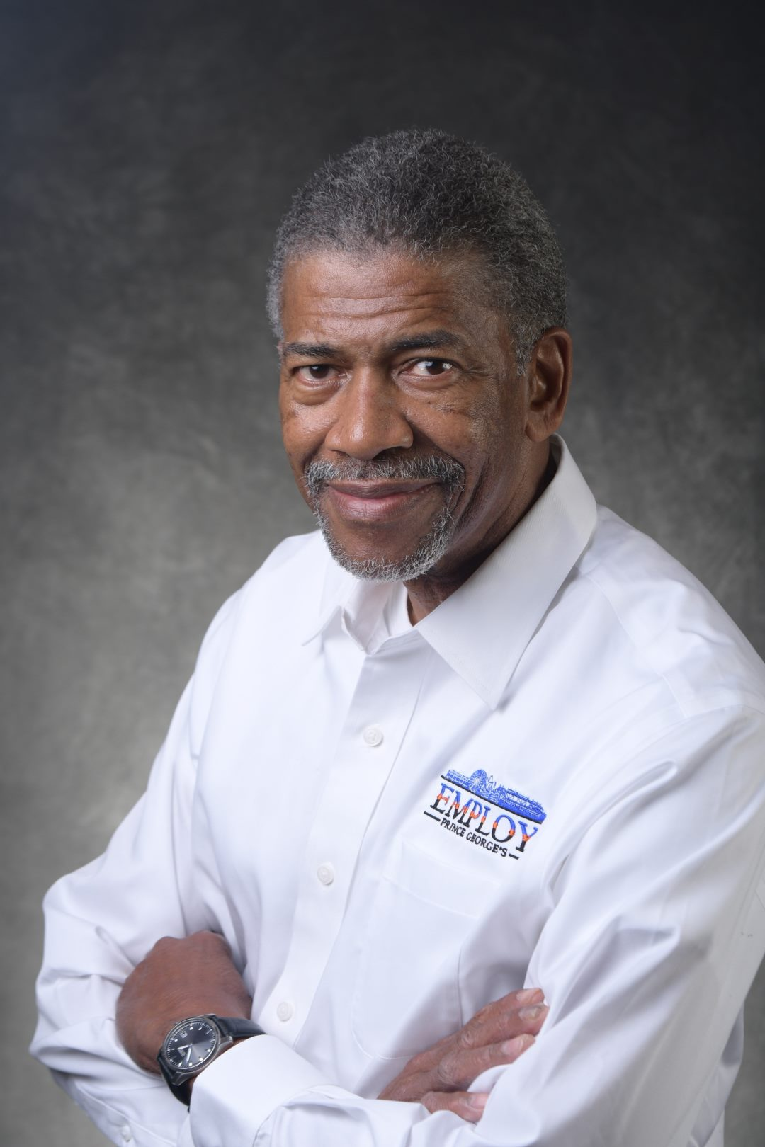
Vernice González
Manager of Job Seeker Services
Pete Goodson
Workforce Development Reentry Coordinator

Slide 3
OUR MISSION
“To provide information, guidance, support and individualized services to businesses and job seekers enabling them to remain competitive in the global economy.”

Slide 4


What is Pathways to Success?
Pathways to Success is a workforce Development Program customized for returning citizens and job seekers with multiple barriers to employment.

Slide 5

What We Do
Job Club
Behind Bars Programs
Career Assessment & Planning
Federal Bonding
Basic Skills Training
Mentoring

Slide 6


Why have programs for Non-custodial Parents?
Pathways to Success provides tools
  Career Development
  Employment/Training
  Expungement
  Federal Bonding
  Supportive Services
Helps customers meet their child support obligations
May in some cases improve parents & children's relationship
40%
Are arrested within three years of their original release date

Slide 7


Barriers Non-Custodial Parents face
Soft skills
Criminal Records
Education/Training
Transportation
Computer Skills
Job Readiness Skills
Lack of Documentation

Slide 8
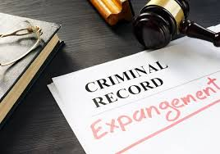
Expungement
How it works
Who Qualify
How to go about it
Partnerships
Maryland Legal Aid
Prince George’s Re-Entry Round Table
Faith Based Organizations
Community Partners
Prince George’s County Courts
Maryland Sate Delegates

Slide 9

Why have Programs
for Returning citizens?
Re-Entry touches and impacts our community from public safety, health, employment, housing, educating, behavioral health, veterans and family.
2.3 Million People are incarcerated in U.S.
More than 95% released int community
Title Text Goes Here, uis nostrud exerci tation ullamcorper suscipit

